Slide 1


Azure as a Developer Platform
Ryan Irujo
Senior Technical Consultant
Notes:
This is a General Overview of what Azure is and the offerings (IaaS) and (PaaS) that are available.

Slide 2
Topics of Discussion
Infrastructure as a Service (IaaS) Offerings
Platform as a Service (PaaS) Offerings

Slide 3

Insider Tip: Topic
When you see these slides, you should pay attention as this is where we will share our best practices from the field
These topics are also great discussions points

Slide 4
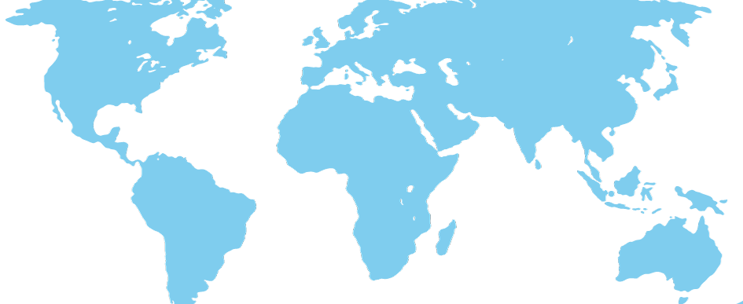




What is Azure?
Global Physical Infrastructure
servers / network / datacenters
Notes:
A Cloud computing platform and infrastructure for building, deploying and managing applications and services through a global network Microsoft-managed and Microsoft partner hosted datacenters. - Provides both IaaS and PaaS services
- Supports a variety of different programming languages and platforms for Windows and Linux

Slide 5
Cloud Models
On Premises
Infrastructure
(as a Service)
Platform
(as a Service)
Software
(as a Service)
You manage
Applications
Applications
Applications
Applications
Data
You manage
Data
Data
Data
Runtime
Runtime
Runtime
Runtime
Managed by Microsoft
You manage
Middleware
Middleware
Middleware
Managed by Microsoft
Middleware
O/S
O/S
O/S
O/S
Managed by Microsoft
Virtualization
Virtualization
Virtualization
Virtualization
Servers
Servers
Servers
Servers
Storage
Storage
Storage
Storage
Networking
Networking
Networking
Networking
Notes:
On Premise:
What is currently managed In-House at your company by your Operations Team. (Servers, Networking, Virtualization, OS, etc..)
IaaS:
You are responsible for managing the Operating System and any software that is installed and configured on it.
Example: Windows Server 2012 R2 VM running SQL Server 2014 SP1
PaaS:
You are responsible for managing only the Applications and Data associated or used by the Applications you are developing. Example: Azure Web Application, Azure SQL Database.
SaaS: Everything is managed for you by a third-party vendor, such as Microsoft.
Example: Office 365, Sharepoint Online

Slide 6
Azure IaaS Offerings

Slide 7
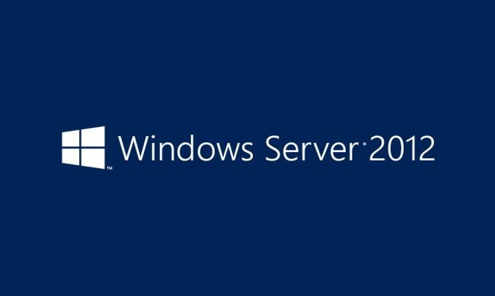

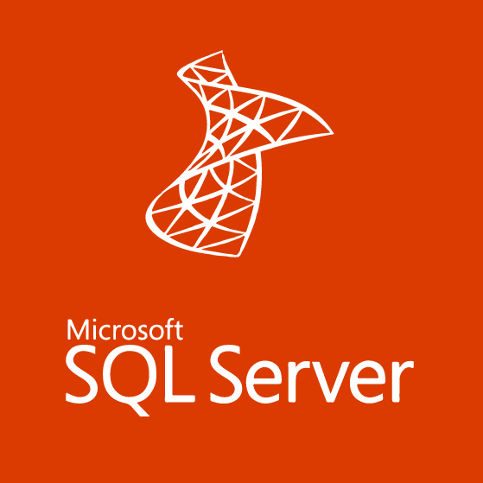
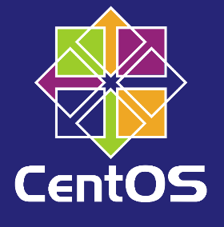
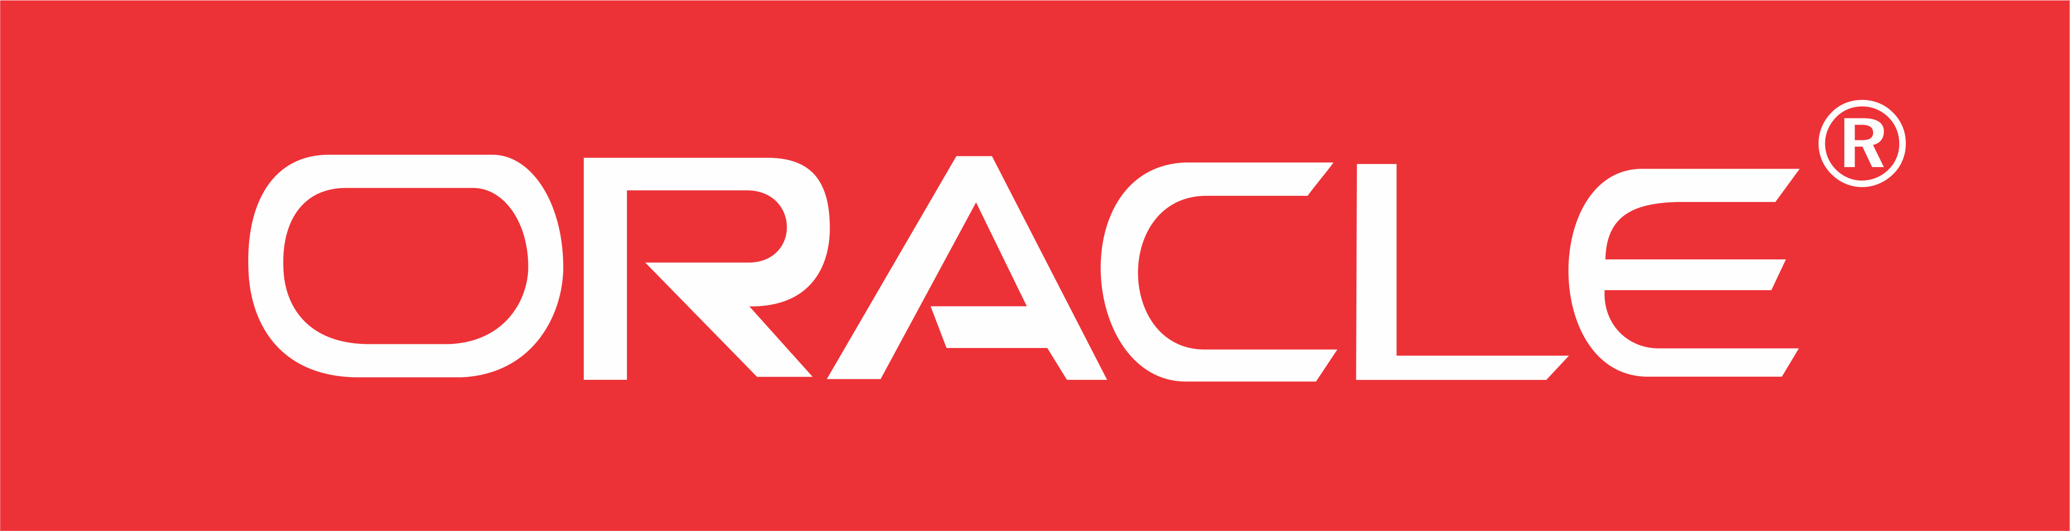
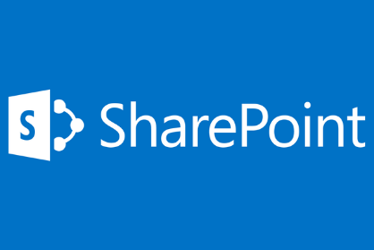

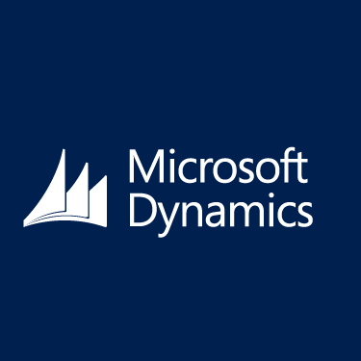
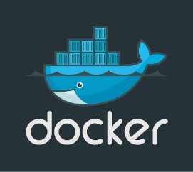

Virtual Machines
Notes:
Azure IaaS VM Offerings Include:
Supported Operating Systems include most major version of Windows and Debian\RedHat flavors of Linux. Additionally, there are several Images available to allow you to create a VM preinstalled with several popular enterprise applications such as Sharepoint or SQL Server. For Open-Source platforms there are Images for Docker, Chef, and Oracle to name a few.

Slide 8
Azure Storage Brief Overview
Cloud Storage – Anytime/Anywhere Access
Blobs, Disks, Tables, Queues, Files
Highly Durable, Available and Massively Scalable
Pay for only what you use
Exposed via REST APIs
Notes:
An entire Day could be spent going over Storage Concepts in Azure, so Storage is only mentioned briefly here to help drive home how resilient the current IaaS Offerings in Azure are.
Introduction to Microsoft Azure Storage: https://azure.microsoft.com/en-us/documentation/articles/storage-introduction/
Storage Documentation: https://azure.microsoft.com/en-us/documentation/services/storage/
Pricing: https://azure.microsoft.com/en-us/pricing/details/storage/

Slide 9
Azure Storage Redundancy
 | Locally Redundant Storage (LRS) | Zone Redundant Storage (ZRS) | Geographically Redundant Storage (GRS) | Read-Access Geographically Redundant Storage (RA-GRS)
How it works | Multiple synchronous copies of your data in one datacenter | Stores 3 copies of data across multiple datacenters within or across regions | Same as LRS + multiple asynchronous copies to secondary datacenter hundreds of miles away | Same as GRS + read access to secondary datacenter
Total copies | 3 | 3 | 6 | 6
Why use it | Economical local storage and data governance compliance | Economical, higher durability option for block blob storage | Protection against major data center outage or disaster | Read-access to data during an outage, maximum data availability and durability
SLA | 99.9% read/write | 99.9% read/write | 99.9% read/write | 99.9% write 99.99% read
Notes:
Azure Storage Replication: https://azure.microsoft.com/en-us/documentation/articles/storage-redundancy/#zone-redundant-storage Pricing: https://azure.microsoft.com/en-us/pricing/details/storage/

Slide 10
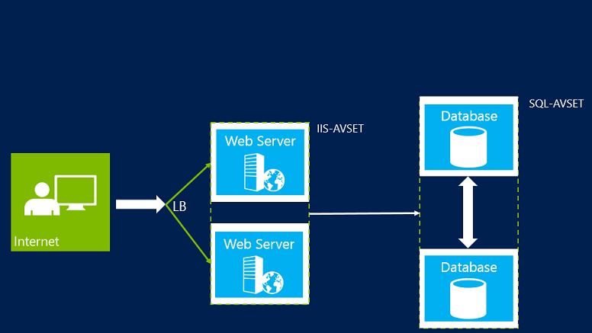
Azure Availability Sets
Assures Availability during planned or unplanned Azure Maintenance Events.
Limits the impact of potential physical hardware, network outages or power interruptions.
Can combine with an Azure Load Balancer for maximum application resiliency
Notes:
Manage the Availability of VMs: https://azure.microsoft.com/en-us/documentation/articles/virtual-machines-manage-availability/#configure-multiple-virtual-machines-in-an-availability-set-for-redundancy
Understanding and configuring Availability Sets: http://michaelwasham.com/windows-azure-powershell-reference-guide/understanding_configuring_availability_sets_powershell/

Slide 11
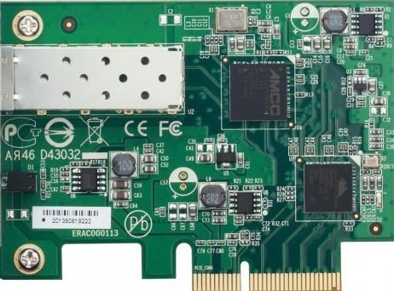

Azure VM Scale Sets (preview)
Manage Virtual Machines as a set
VMs are configured Identically
Rapid scalability (in & out)
Ideal for stateless web front-ends and container orchestration
Support for Windows and Linux Platforms
Currently can only scale out to 100 VMs per Scale set while in Preview
Resource Group
Scale Set
Subnet
…
VM
VM
VM
Scalable NIC
Scalable Storage
Extensions
VNET
Notes:
Azure Virtual Machine Scale Sets Overview: https://azure.microsoft.com/en-us/documentation/articles/virtual-machines-vmss-overview/
Azure VM Scale Sets public preview: https://azure.microsoft.com/en-us/blog/azure-vm-scale-sets-public-preview/
ARM Template Example: https://github.com/Azure/azure-quickstart-templates/tree/master/201-vmss-linux-nat

Slide 12
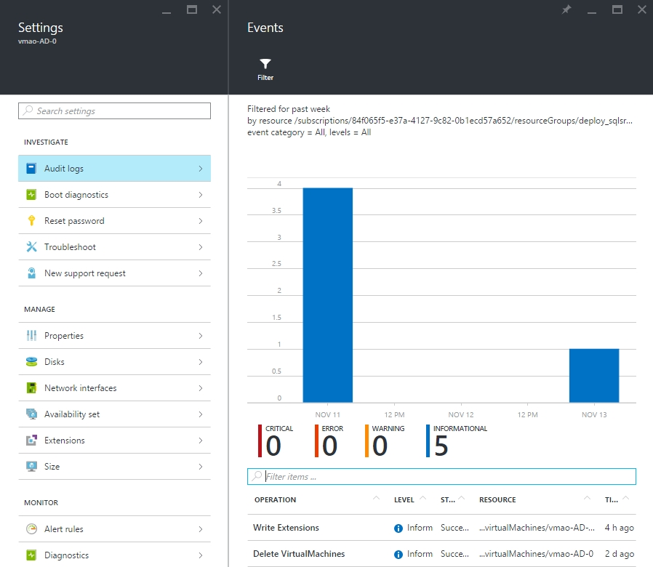
Azure IaaS Audit Logs Available
Availability Set
Virtual Machines
Load Balancer
Network Interface
Public IP Address
Virtual Network
Storage
Notes:
As SQL Server in Azure VM is almost the same as running SQL Server on an on-premise VM, all components that make up deployment in Azure are potential resources for reviewing logs.

Slide 13
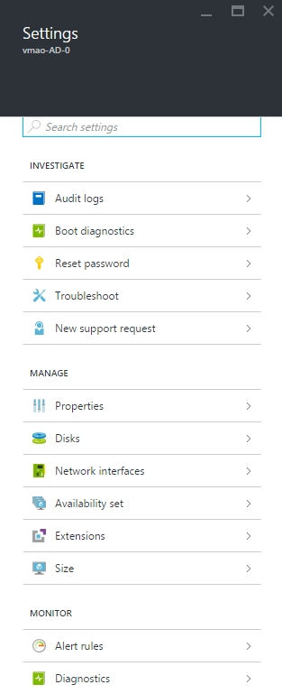
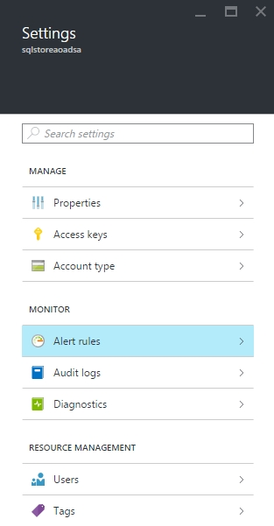
Azure IaaS Monitoring Options
Infrastructure
(as a Service)
Virtual Machines
Storage
System Center
OMS
Applications
You manage
Data
Runtime
Middleware
O/S
Managed by Microsoft
Virtualization
Servers
Storage
Networking
Notes:
Alert Rules & Diagnostics can be configured for both Virtual Machines and Storage Containers.

Slide 14
Azure PaaS Offerings

Slide 15
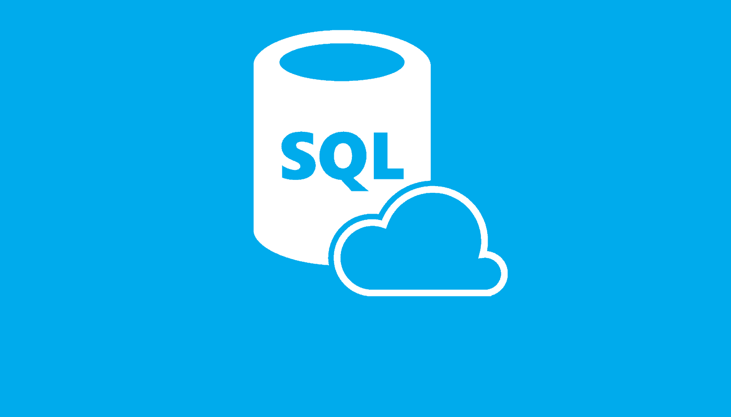
Azure SQL
No SQL Server license required
Max DB Size: 500 GB
Cost based on Data Throughput Units (DTU’s)

Slide 16
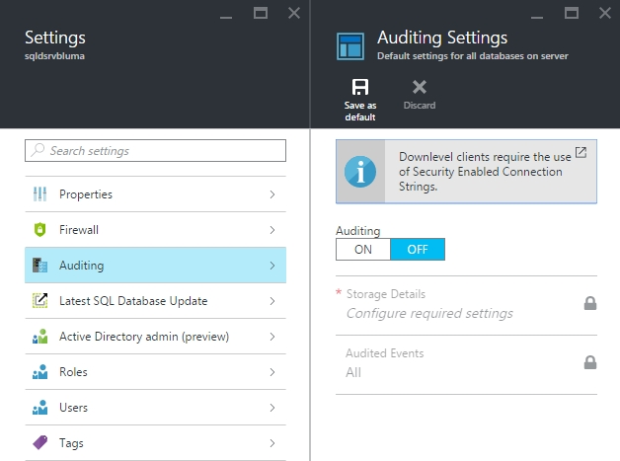
Audit Logs Available
SQL Server
SQL Database
Notes:
Auditing features are turned off by default on both Azure SQL Servers and Azure SQL Databases. You have the option to inherit Auditing settings from the Azure SQL Server to the Azure SQL Database if you decide to add additional databases later on.

Slide 17
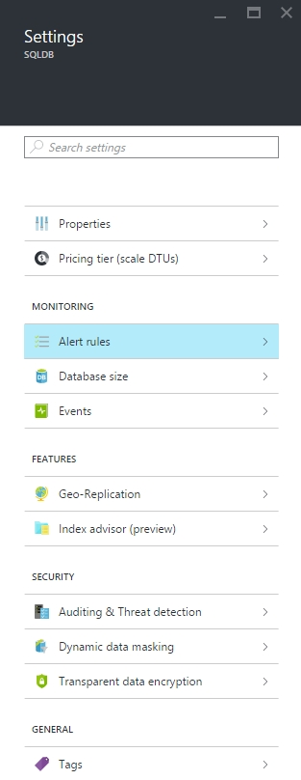
Azure SQL Monitoring Options (PaaS)
Platform
(as a Service)
Azure SQL Databases
System Center
You manage
Applications
Data
Runtime
Middleware
Managed by Microsoft
O/S
Virtualization
Servers
Storage
Networking
Notes:
Alert Rules can be configured for Azure SQL Databases but not for Azure SQL Servers.

Slide 18
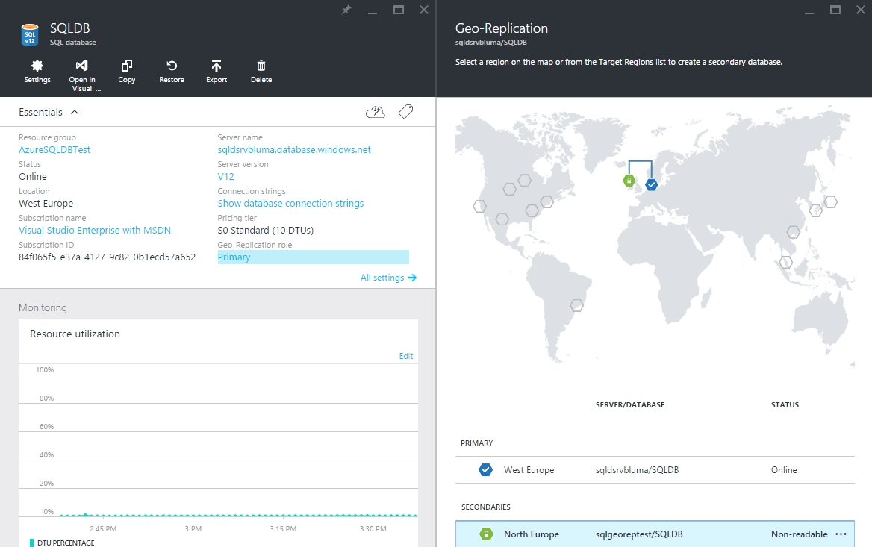
Geo-Replication for SQL Databases (PaaS)
Azure SQL Databases can be configured with Geo-Replication
Notes:
Requires the creation of an additional Azure SQL Server and Azure SQL Database in another Azure Region as shown on the map.

Slide 19
Insider Tips: Geo-Replication for SQL Databases (PaaS)
Geo-replication in Azure disks does not support the data file and log file of the same database to be stored on separate disks.
Notes:
High Availability and Disaster Recovery for SQL Server in Azure Virtual Machines: https://azure.microsoft.com/en-us/documentation/articles/virtual-machines-sql-server-high-availability-and-disaster-recovery-solutions/?rnd=1
Alternatively, a more cost-effective solutions is to create a Point-In-Time Restore either manually or using Azure Automation.

Slide 20


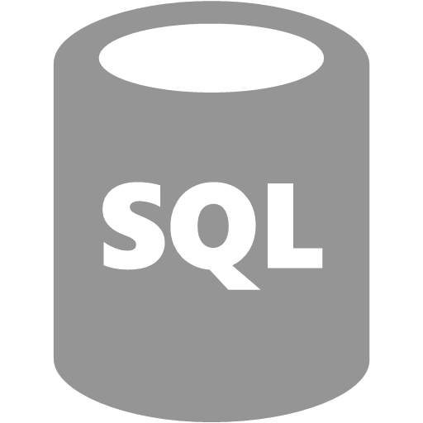
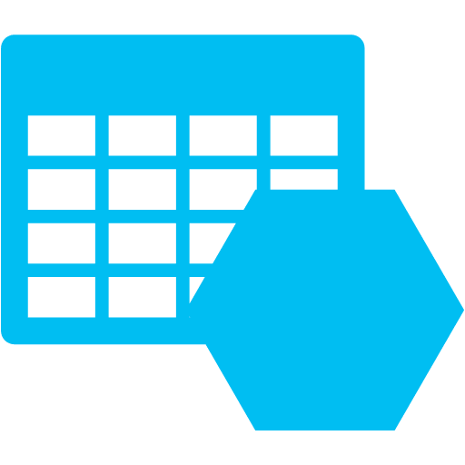
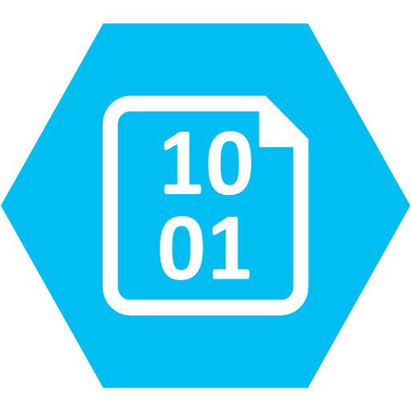
Hybrid Data Platform: Microsoft Azure Options
AlwaysOn Availability Group
Primary
Secondary
Backup to cloud (optionally managed)
Azure Storage integration
Azure Storage
Hybrid
On-premises
Option | SQL Version
AlwaysOn Availability Group Backup to Cloud | SQL Server 2012 (and newer) SQL 2005 (and newer)
Azure Storage Integration | SQL 2014 (and newer)
Notes:
SQL Backup Options available to you in Azure.

Slide 21
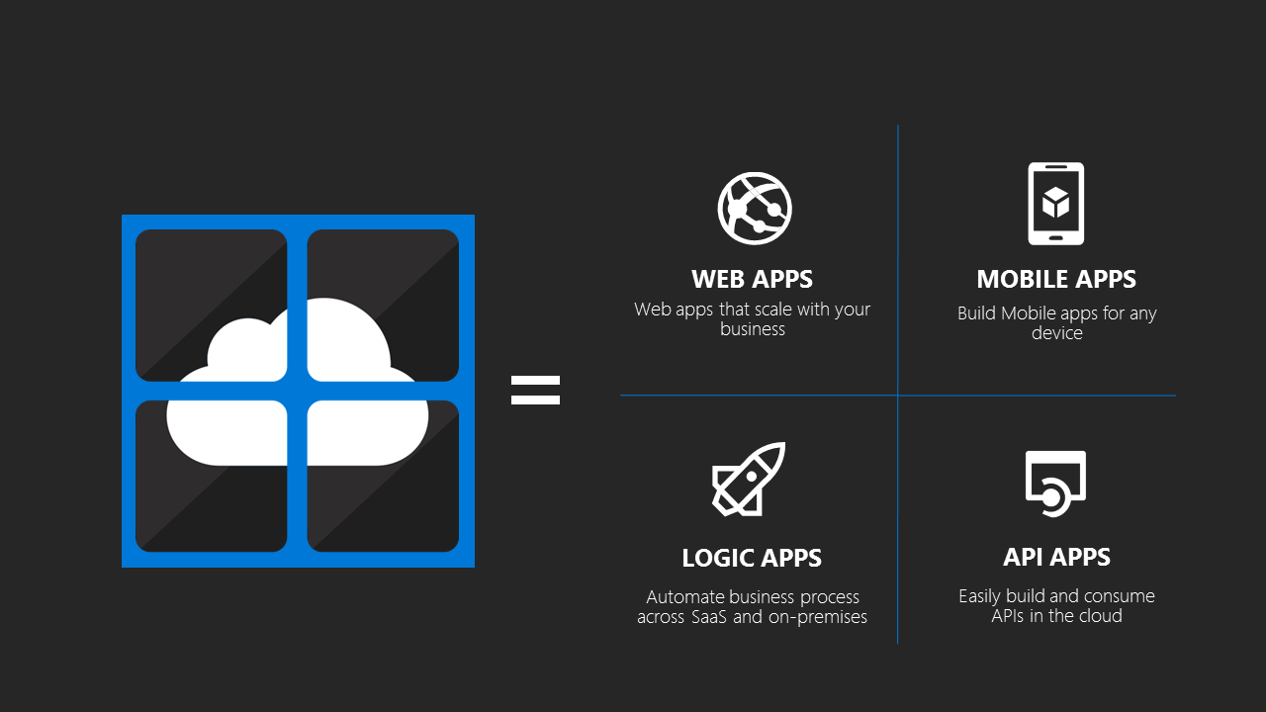
Azure App Service
Notes:
Azure App Service is a single service that includes the existing capabilities available in Azure Websites, Azure Mobile Services and Azure Biztalk Services and new capabilities as they are rolled out. The four main areas which we will discuss in the next slides are Web Apps, Logic Apps, Mobile Apps, and API Apps.
What is Azure App Service?: https://azure.microsoft.com/en-us/documentation/articles/app-service-value-prop-what-is/

Slide 22
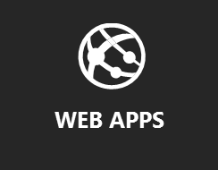
Web Apps
Supports .NET, Java, PHP, node.js, and Python
Built-in autoscale and load balancing
High availability with auto-patching
Support continuous deployment using tools like TFS and GitHub
Support for Wordpress, Umbracco, Joomla and Drupal
Notes:
Web Apps Overview: https://azure.microsoft.com/en-us/documentation/articles/app-service-web-overview/

Slide 23
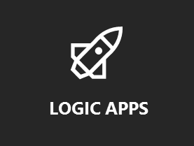
Logic Apps (preview)
Visually create business processes and workflows
Deliver integration capabilities in web, mobile, and API app
Integrate with your SaaS and enterprise applications
Automate business processes
business-to-business (B2B)
Enterprise Application Integration (EAI)
Connect to On-Premise data
Notes:
Logic Apps Overview: https://azure.microsoft.com/en-us/documentation/articles/app-service-logic-what-are-logic-apps/
Again, note that this is currently in preview!

Slide 24
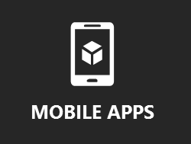
Mobile Apps (preview)
Build native and cross platform apps. (iOS, Android, Windows)
Connect to Enterprise Systems
Support for over 40 SaaS API Connectors
Single Sign, Offline Sync, Push Notifications and Auto Scaling
Notes:
What are Mobile Apps?: https://azure.microsoft.com/en-us/documentation/articles/app-service-mobile-value-prop/
Again, note that this is in preview.

Slide 25
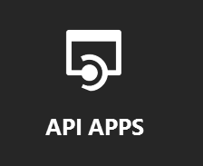
API Apps (preview)
Platform for building, hosting and consuming APIs in the cloud or on-premise.
Integration with swagger (YAML)
cross-origin resource sharing (CORS) configurable.
Visual Studio Integration
Integration with Logic Apps
Notes:
API Apps Overview: https://azure.microsoft.com/en-us/documentation/articles/app-service-api-apps-why-best-platform/

Slide 26

Azure Service Fabric (preview)
“Born in the Cloud” Applications
Develop stateless and stateful (micro)services in place of caches and queues
Develop stateful (micro)services in place of caches and queues
Rapid Deployment (seconds)
Manage Applications using .NET APIs, PowerShell or REST
Self-healing
Notes:
Overview of Service Fabric: https://azure.microsoft.com/en-us/documentation/articles/service-fabric-overview/
Microsoft Azure Service Fabric Architecture: https://www.youtube.com/watch?v=LojNfHmnz1I
You can almost think of this as Microsoft’s Container Implementation to Scale that’s in-house, a cloud service and operates similarly to Apache Mesos or Kubernetes.

Slide 27
© 2015 Microsoft Corporation. All rights reserved. Microsoft, Windows, Windows Vista and other product names are or may be registered trademarks and/or trademarks in the U.S. and/or other countries.
The information herein is for informational purposes only and represents the current view of Microsoft Corporation as of the date of this presentation. Because Microsoft must respond to changing market conditions, it should not be interpreted to be a commitment on the part of Microsoft, and Microsoft cannot guarantee the accuracy of any information provided after the date of this presentation.
MICROSOFT MAKES NO WARRANTIES, EXPRESS, IMPLIED OR STATUTORY, AS TO THE INFORMATION IN THIS PRESENTATION.

